Slide 1
ElectroKinetic Soil Treatment Inc.
The EKST Process
perumin Hub 2022
For more information
Contact info@ekst.ca
Visit https://electrokineticsolutions.com/ekst/
Notes:
This presentation provides an overview of the EKST process, an innovative technology for decontaminating contaminated soil.
For more information on this technology, email info@ekst.ca or visit https://electrokineticsolutions.com/ekst/,

Slide 2
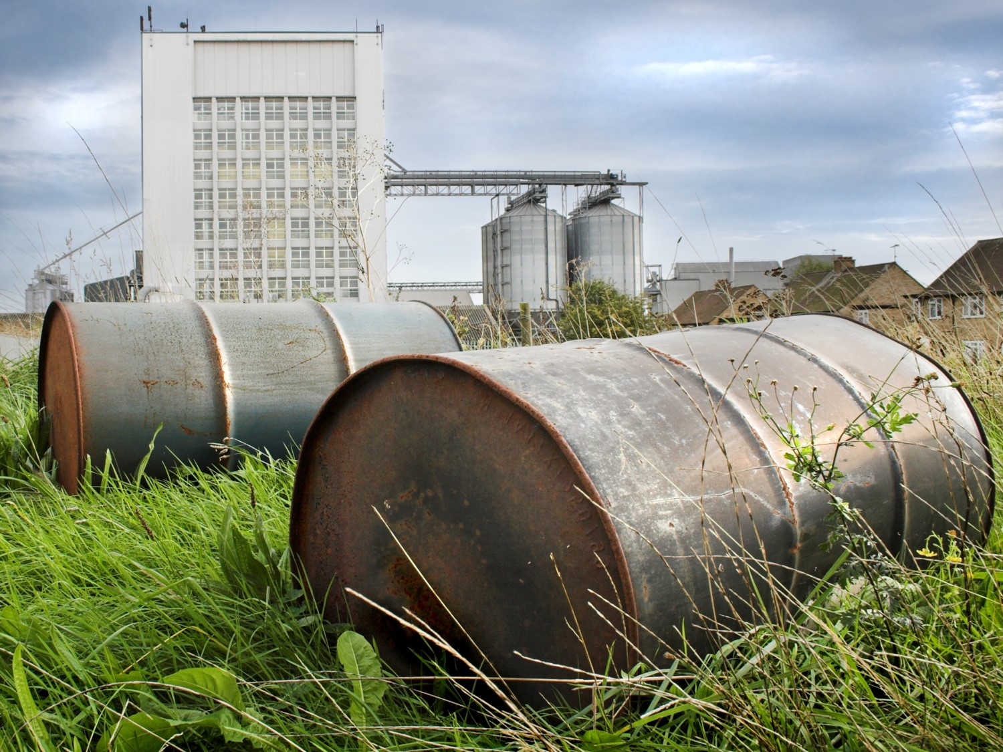
Demand for Soil Decontamination
Soil contamination is a major issue in many industrial sectors including mining
Site decontamination globally is a multibillion-dollar industry
Soil contaminants include organic and inorganic pollutants
An environmentally sustainable means to decontaminate sites is needed that avoids the high costs and environmental impacts of removing contaminated soil for treatment and disposal
Notes:
Soil contamination is a major issue in many industrial sectors including mining
Site decontamination globally is a multibillion-dollar industry
Soil contaminants include organic and inorganic pollutants.
An environmentally sustainable site decontamination process is needed that avoids the high costs and environmental impacts of current site decontamination methods

Slide 3
The EKST Process

Slide 4
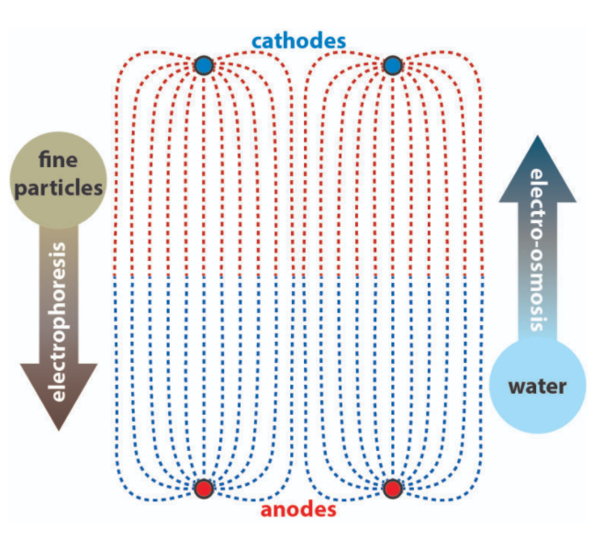
The EKST Process Physics
Two electrokinetic forces at work:
Electroosomosis
Drags electrolyte toward the cathodes
Flow rate is dependent on electric field strength
Most effective with most difficult media (e.g. fine grained clays)
Electromigration
Draws dissolved ions to oppositely charged electrodes
Rate of ion migration is dependent on electric field strength
Electrolyte “recipe” is important for decontamination effectiveness
Notes:
The EKST process is based on two electrokinetic forces.
First, electroosomosis
Drags electrolyte toward the cathodes carrying contaminants with it
The electrolyte flow rate is dependent on the strength of the electric field which can be adjusted by the control system. Increasing the electrolyte flow rate increases the rate at which soil can be decontaminated and increases the mass of contaminants removed
The other electrokinetic force is electromigration.
Electromigration attracts dissolved ions to the oppositely charged electrodes assisting the electroosmotic process.
The rate of ion migration is also dependent on the electric field strength
The electrolyte “recipe” is important for decontamination effectiveness. The recipe is customized to the soil and contaminant conditions of each project.

Slide 5
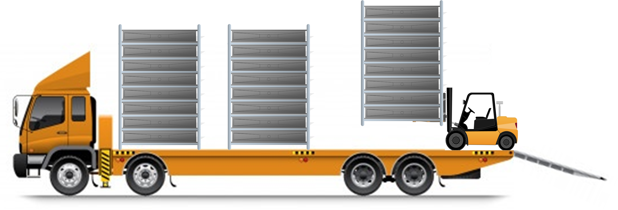
Mounted Decontamination Units
Business Confidential; Not to be disclosed or used for any other purpose
Notes:
This graphic shows the stacked decontamination units being mounted on a flat bed.
The process:
Is low cost – Much less material handling is required
Occurs onsite so that no hauling of soil offsite is required.
Is mobile The treatment system is transported by truck from one contaminated site to the next
Is highly flexible
The throughput capacity of a deployed system is optimised based on the specific requirements of a project, not one-size-fits-all.
Inorganic and organic pollutants are removed by tailoring the electrolyte recipe to the pollutants present.
The process can meet stringent environmental requirements without any major changes

